Slide 1

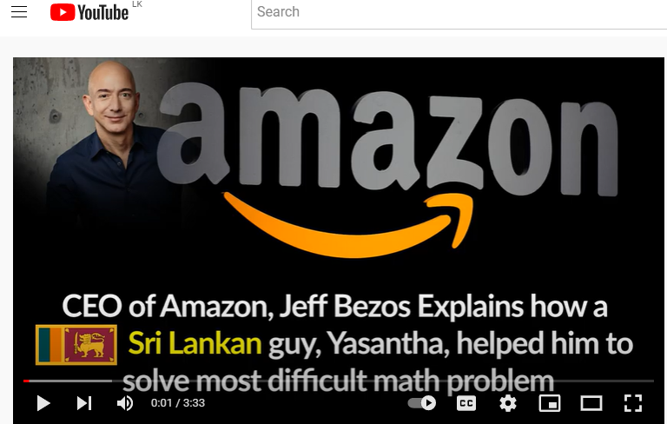

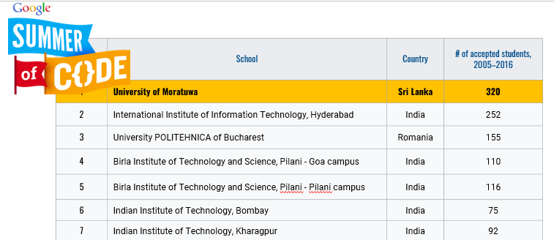
Sri Lanka has been dominating Google Summer of Code consistently between 2005 – 2018

Slide 2
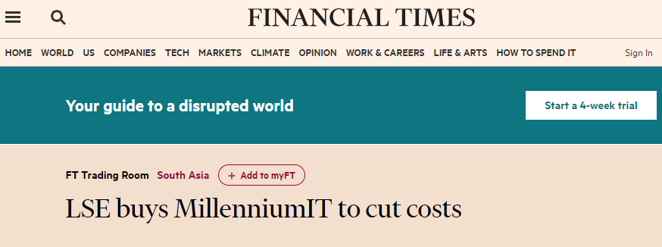
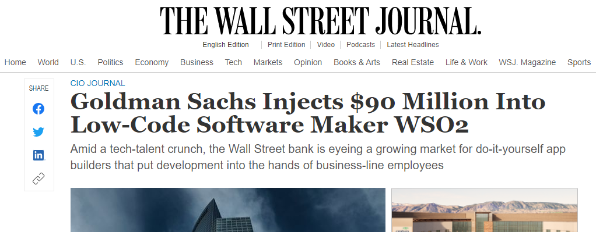

Millennium IT powers London Stock Exchange
WSO2 Powers eBay

