Slide 1



Ministry of Industry &
Entrepreneurship Development
Sri Lanka
Export Development Board

Slide 2
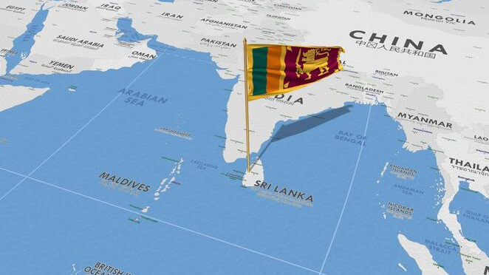
Sri Lanka
It is Your Gateway to Global Market
Strategic Location
At the crossroads of global shipping routes, linking Asia, Europe, and the Middle East.
Quality of Life
A safe, vibrant destination with modern facilities and an attractive lifestyle.
Talent & Skills
A skilled, English-proficient workforce with growing technical expertise.
Logistics & Connectivity Advantage
Efficient ports and airports providing seamless access to global markets.

Slide 3





Sri Lanka
FDI Inflows (USD Bn):
2023 – 0.76
2024 – 0.85
2025 – Over 1.00
Economic Strengths at a Glance
GDP & Export Performance
GDP: US$ 99.0 Bn (2024)
GDP Growth Rate: 5%(Jan – Sept 2025)
Per Capita GDP :(USD) 4,516(2024)
Exports: USD 16.2 Bn (2024)
Export Growth Rate : 5.8%( Jan- Nov 2025)
Free Trade Agreements
FTAs with India and Pakistan
Singapore and Thailand
Tourism Rankings
One of the 50 Best Places to Travel in 2026 – Travel + Link
The Top 10 Happiest Travel Destinations for Meaningful Travel for 2026 – G Adventures
Among the Best Places to Visit in Asia for 2026 – U.S. News
Preferential Market Access
Zero-duty access for 6,400+
items to 27 EU countries under EU GSP+
100% duty-free access to UK under DCTS
Notes:
FTAs with India and Pakistan – fully operating
Singapore - Comprehensive FTA - implemented
Thailand – Comprehensive FTA – to be implemented

Slide 4


Strategic Focus of Sri Lanka Expo 2026
Promote Sri Lanka as a key trade and investment hub in South Asia
Showcase Sri Lanka’s diverse industries, including agricultural, industrial, knowledge services and tourism
Provide a networking platform for businesses, investors, and policymakers
Instill buyer/investor confidence in Sri Lanka’s service offering
Facilitate knowledge sharing through thematic conferences

Slide 6

Projected Outcome
Increase Sri Lankan exports: Move towards national export target of US$ 36 Bn by 2030
Increase foreign direct investments & Joint Ventures for key Sri Lankan industries
Enhance international visibility of Sri Lankan businesses and products
Diversification in to new markets
Increase Tourist arrivals to Sri Lanka

Slide 7
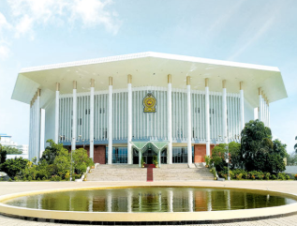
Event Details
 | Dates & Duration
 | 18ᵗʰ to 21ˢᵗ June 2026
 | Four (04) Days (First 3 days exclusively for buyers & investors, last day will be open to public)
 | Venue
 | BMICH Colombo Sri Lanka
 | Exhibitors
 | 750 Exhibitors
 | Sri Lankan Exporters International Pavilion for High Tech, Machinery Exporters (Approx. 100 )
 | Target Audience
 | Buyers/ Investors / Journalists 1,500 +
 | International businesses, investors, journalists, Government officials, industry leaders, leading exporters and entrepreneurs

Slide 8







Product Sectors
  Apparel, Textile & Fashion
  Gems & Jewellery
  Boat & Ship Building
  Engineering & Auto Components
  Rubber & Polymer Products
  Electrical & Electronics
  Lifestyle & Handicrafts
  Pharmaceuticals
  Minerals & Mineral-based Products
Industrial Products
Agricultural Products
Tea
Spices & Concentrates
Coconut-based Products
Fisheries Products
Processed Foods & Beverages
Ayurveda & Herbal Products
Cut Flowers & Foliage
Ornamental Fish
Fruits & Vegetables

Slide 9









Services
ICT/BPM
Logistics
Marine & Off-Shore Services
Marine & Off-Shore Services
Wellness & Healthcare
Construction & Renewable Energy

Slide 10





Thematic Pavilion
Sustainable & Green solution
Innovation & Technology
Future Export Leaders
Culture, Heritage & Craftsmanship
Global Partnerships

Slide 11


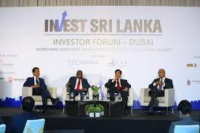



Parallel Events
Investment Forum
📅 19th June 2026
🕔 02.00 p.m. – 05.00 p.m
BMICH-Main Hall & Lavender Hall
Product Specific Forums
📅 June 18, 2026
10:30 AM – 11:30 AM, 02:00 PM – 03:00 PM
📅 June 19, 2026
10:30 AM – 11:30 AM, 02:00 PM – 03:00 PM
Lavender Hall & Orchid Hall
Notes:
Investment Forum
A dynamic platform connecting investors with high-growth opportunities across priority sectors, showcasing bankable projects and innovation-driven enterprises while fostering strategic partnerships and sustainable investments aligned with global market trends.
Product Specific Forums
Focused platforms connecting buyers and stakeholders with sector-specific products, showcasing innovation, quality, and market-ready solutions while fostering trade partnerships, business collaborations, and opportunities for export growth.

Slide 12





Parallel Events
Culinary Show
📅 18th June 2026 🕔 1.00 p.m. – 3.00 p.m.
📅 19th -20st June 2026-🕔 10.00 p.m. – 12.00p.m and 🕔 1.00 p.m. – 3.00 p.m
📅 21st June 2026 -🕔 10.00 p.m. – 12.00 p.m.
BMICH – In front of the Hall A & B
Fashion Show
📅 19th & 20th June 2026
🕔 5.00 p.m. – 6.00 p.m
BMICH – In front of Hall C & D
Notes:
Culinary Show
Sri Lanka’s rich culinary heritage will take center stage at EXPO-2026, showcasing the island’s unique food ingredients, spices, and culinary expertise, offering an unparalleled sensory experience.
Fashion Show
Glamour Sri Lanka: Expo 2026’s fashion destination, showcasing key export products through a dynamic runway blending heritage, craftsmanship, sustainability, and innovation.

Slide 13


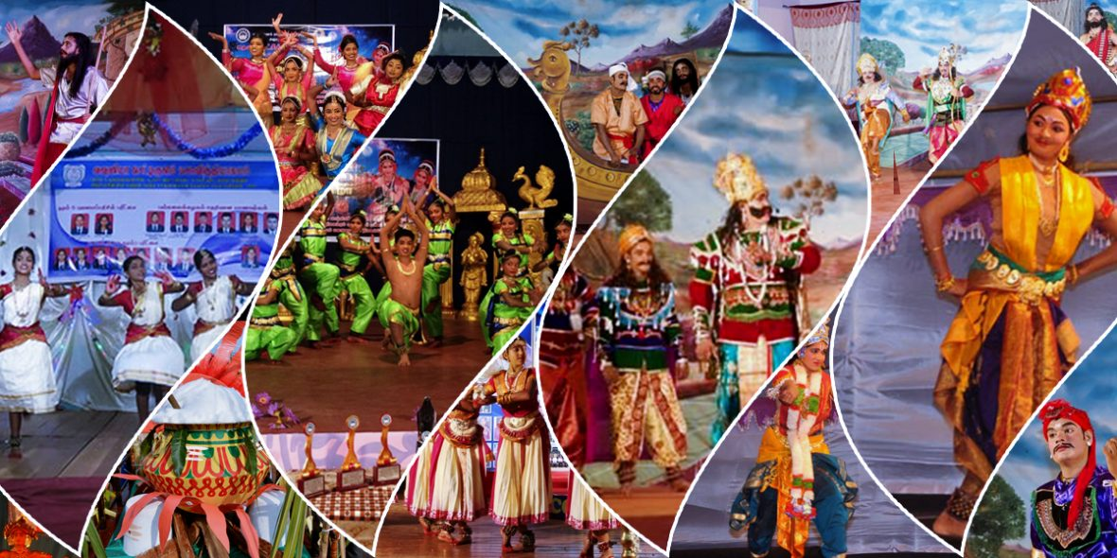
Parallel Events
Cultural Show
📅 18th June 2026
🕔 5.00 p.m. – 7.00 p.m.
BMICH – Main Hall
Notes:
Cultural Show
Wonder of Heritage: Experience Sri Lanka’s rich culture through a dynamic blend of traditional dance and music, where ancient traditions meet contemporary creativity.

Slide 14





Parallel Events
B2B Meetings
📅 18th June 2026 🕔 1.00 p.m. – 3.00 p.m
📅 19th -20st June 2026-🕔 10.00 p.m. – 12.00p.m and
🕔 1.00 p.m. – 3.00 p.m
📅 21st June 2026 -🕔 10.00 p.m. – 12.00 p.m.
BMICH – Lotus Hall
New Product Pitch
📅 18^{th –} 21st June 2026
BMICH – Lobby Area Hall A & B
Notes:
B2B Meetings
Facilitating direct interactions between Sri Lankan exporters and international buyers, fostering strategic partnerships, exploring business opportunities, and driving trade growth.
New Product Pitch:
A platform for Sri Lankan exporters to showcase innovative, market-ready products to international buyers, highlighting unique value propositions, fostering business interest, and creating opportunities for trade expansion.

Slide 15
BUYER & INVESTOR ATTRACTION
Target 1500+
Number of Targeted buyers by Regions
Region | Target
Asia & Pacific | 500
Europe | 500
Americas | 400
Middle east , Russia, CIS | 300
Africa | 100

Slide 16




Buyer Facilitation & Opportunities
  Complimentary accommodation at a star-class hotel for qualified buyers on a first-come, first-served basis
  Attractive accommodation packages ( links for discounted hotels & airfare) specially arranged for other registered international buyers
  Special package for coordinating officers handling a group of delegates
  Special package for International journalists

Slide 17

Buyer Facilitation & Opportunities
  Discounted air tickets by Sri Lankan Airlines
  Airport Pick up & drop
  Shuttle service from the Hotel to Expo venue
  Visa invitation letters
  Pre-arranged B2B meetings with leading Sri Lankan exporters
  Invitations for Investment forum and Industry sessions
  Invitations for fashion, culinary, and cultural shows
  Event E catalog, Expo help desk, VIP Lounge access at Expo venue

Slide 18



Partners

Slide 19




EDB Welcomes
International Leading Sri Lankan
Buyers & Investors Exporters
To explore Strategic Business Opportunities @
18ᵗʰ – 21ˢᵗ JUNE 2026 AT BMICH , COLOMBO
CHAIRMAN & CHIEF EXECUTIVE OFFICER
SRI LANKA EXPORT DEVELOPMENT BOARD
NO 42, NAWAM MAWATHA, COLOMBO 02
SRI LANKA
Tel: +94 112300705-11, Fax: +94 112300715
www.srilankaexpo.lk
Contact:
expo@edb.gov.lk

